Slide 1
Comparable and Comparator interfaces

Slide 2
Intro
Lists (and arrays) of objects that implement Comparable interface can be sorted automatically by Collections.sort (and Arrays.sort).
Let’s see an example

Slide 3
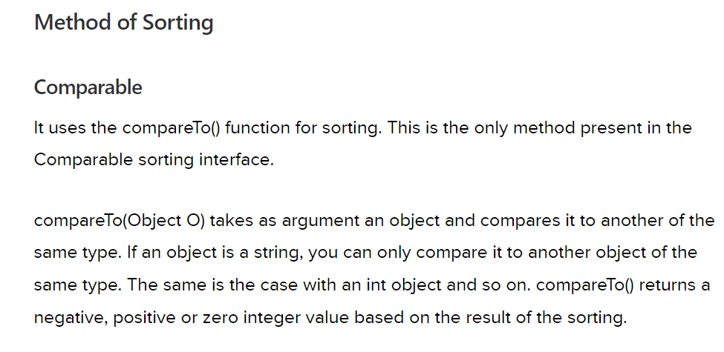

Comparable interface is mainly used to sort the arrays (or lists) of custom objects.

Slide 4
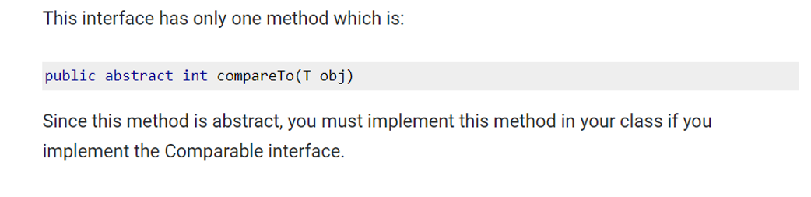
Let’s see an example
Sorting using Comparable affects the actual class.

Slide 5
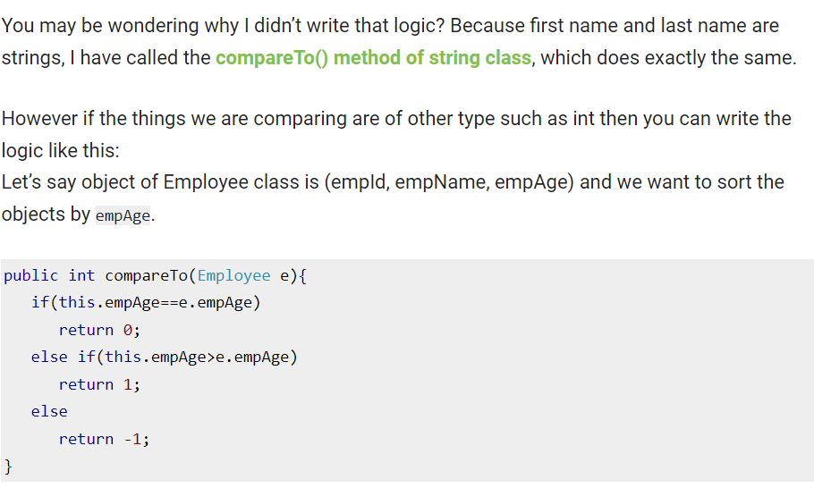
Let’s see an example

Slide 6
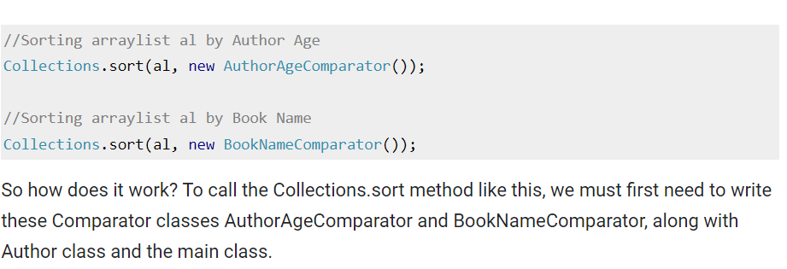
Comparator Interface
But what if we want to have multiple sort choices and we can sort objects based on any choice, this can be done using Comparator interface, we can create as many Comparator as we want and then we can call Collections.sort on one or more Comparator

Slide 7
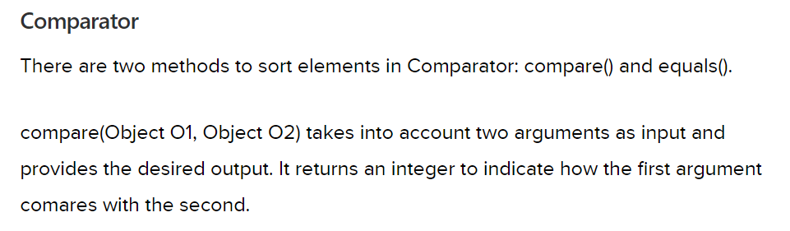
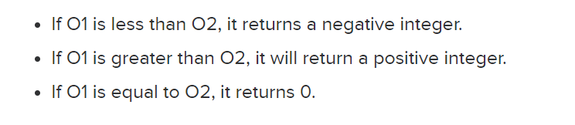
Let’s see an example
The actual class remains unaffected.

Slide 8
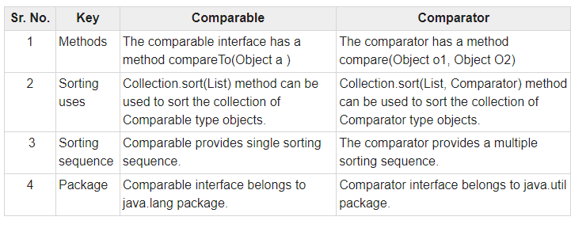
Difference: They are part of the Java Collections Framework and provide mechanisms to define the natural ordering of objects (Comparable) or to specify custom sorting logic (Comparator).

Slide 9
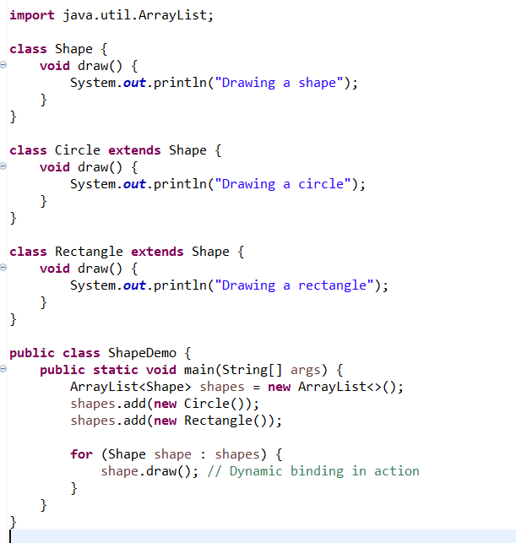
ArrayList and Dynamic Binding

Slide 10
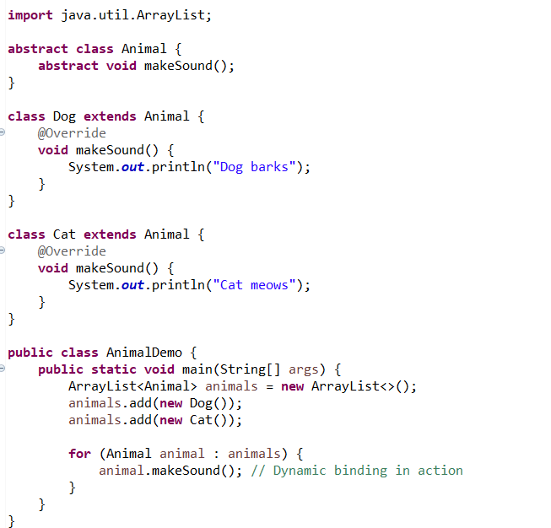
Dynamic Binding and Abstract Classes

Slide 11
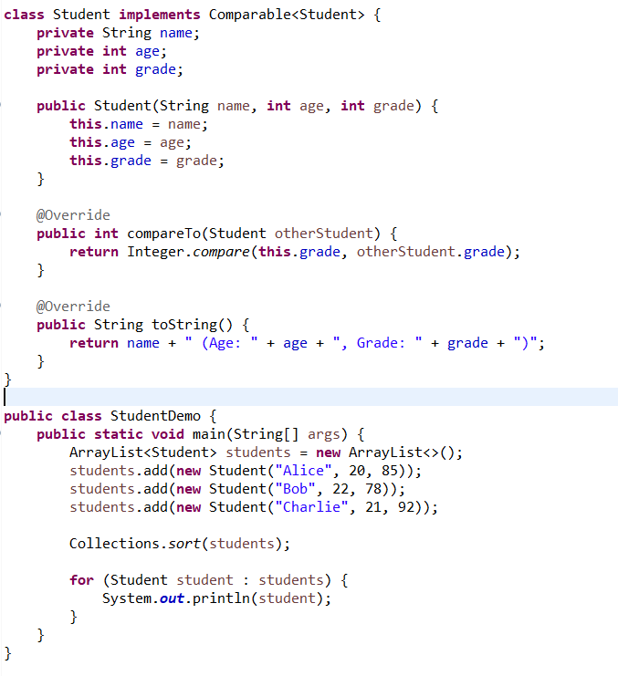
Comparable interface

Slide 12
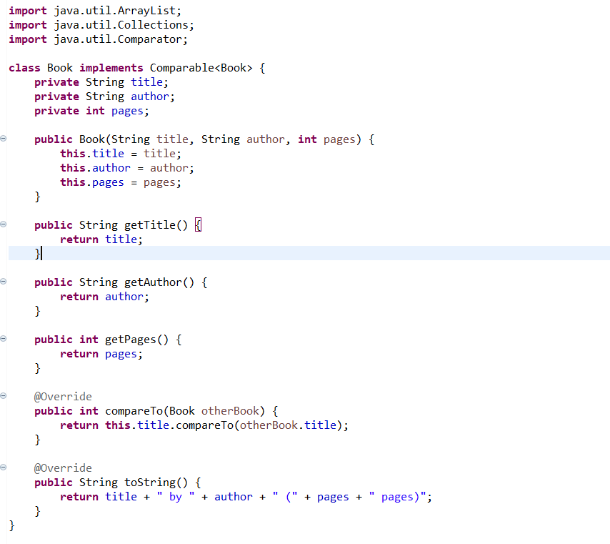
Both ComparableandComparator

Slide 13
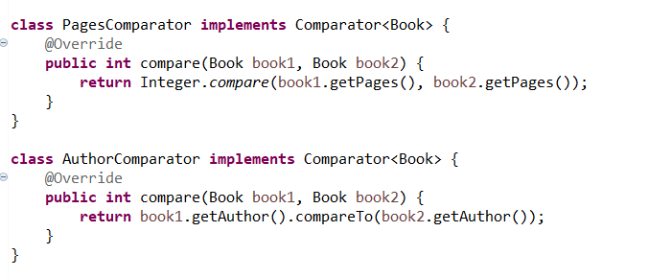

Slide 14
